Slide 1
TPMT
one man’s medicine, the other man’s poison Adriana Ključarić

Slide 2
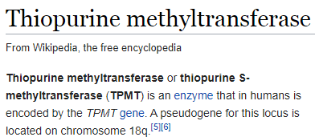
-TPMT catalyzes S-methylation (reaction that inactivates thiopurine drugs)
Clinical significance: Thiopurine drugs ( 6-mercaptopurine, Azothioprine) used as chemotherapeutic agents and immunosuppressive drugs (1/3000 deficient for the enzyme)

Slide 3
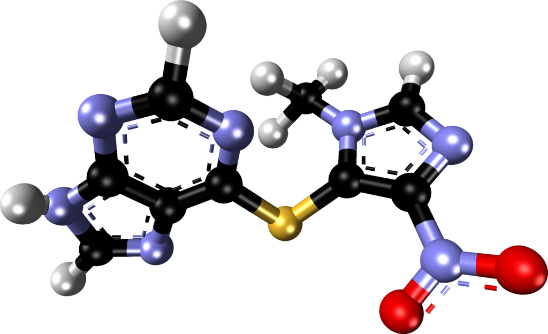
Example of thiosine drug
Azathioprine (AZA)
immunosuppressive medication
used in: rheumatoid arthritis, Crohn’s disease, ulcerative colitis, systemic lupus erythematosus and in kidney transplants to prevent rejection
per os or through i.v.

Slide 4
- Pharmacology: TPMT best known for its role in the metabolism of thiopurine drugs. Defects in TPMT gene leads to decreased methylation and decrease inactivation of 6MP → anemia, bleeding tendency, leukopenia... - Diagnostic use: measurment of TPMT activity should be done before treating the patients with thiopurine drugs
- if low activity- → high risk of drug induced bone marrow toxicity

Slide 5
Most common TPMT variant allele in European population is TPMT*3A (minor allele frequency 5%)
→ 1 of every 300 European subjects being homozygous for this variant- is due to 2 nonsynonymous single nucleotide polymorphism (SNPs) in the TPMT gene
→ Those 2 changes in nucleotide sequence result in the alteration of 2 AA in the TPMT protein

Slide 6
Protein encoded by TPMT*3A is translated, but it misfolds and is rapidly degraded = lack of enzyme and inability to metabolize thiopurines → leading to 10x „overdose” of these cytotoxic agents
(when a standard dose of thiopurine is administered to patients who are homozygous for TPMT*3A)

Slide 7
What exactly is TPMT*3A?
Haplotype* containing 2 nonsynonymous SNPs (*3B (codon 154 SPN) and *3C)
most common in European population
Haplotype results in significant decrease in TPMT enzymatic activity resulting in toxicity when thiopurine tharapy is administered * - group of alleles in an organism that are inherited together from a single parent

Slide 8
BLUE- residue 240 PINK- residue 154

Slide 9
RED- SAH (catalytic activity)

