Slide 1
Ionic semiconductor sequencing (Iontorrent)
Adriana Ključarić 9th of January 2020

Slide 2
Ion proton semiconductor sequencer

Slide 3
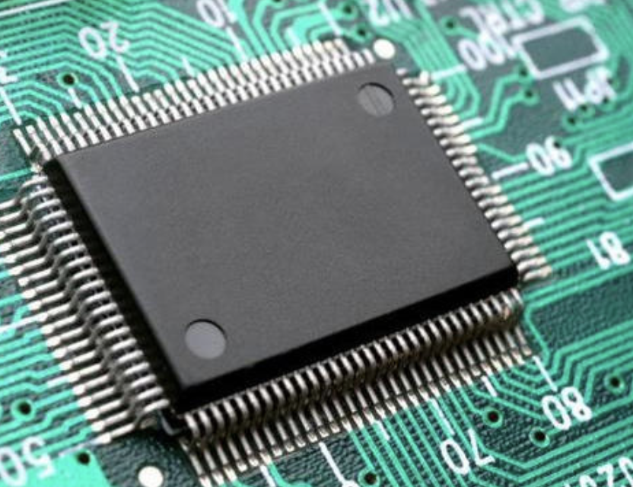
Faster, simpler, more affordable
Sequencing is done by using a semiconductor chip ( similar to chip in digital camera)
Ion chip has millions of wells covering ’pixels’ - wells capture chemical inforamtion from DNA sequencing → translate it into digital information
(Sequencing process starts when a sample of DNA is cut up into millions of fragments, each fragment attaches to its own bead and is copied until it covers the bead) x millions
Beads then flow across the chip, each depositing into a well → the chip is flooded with one DNA nucleotides
Whennever a nucleotide is incorporated into a single strand of DNA → H⁺ is released ( this is how ion torrent system sequences DNA)

Slide 4
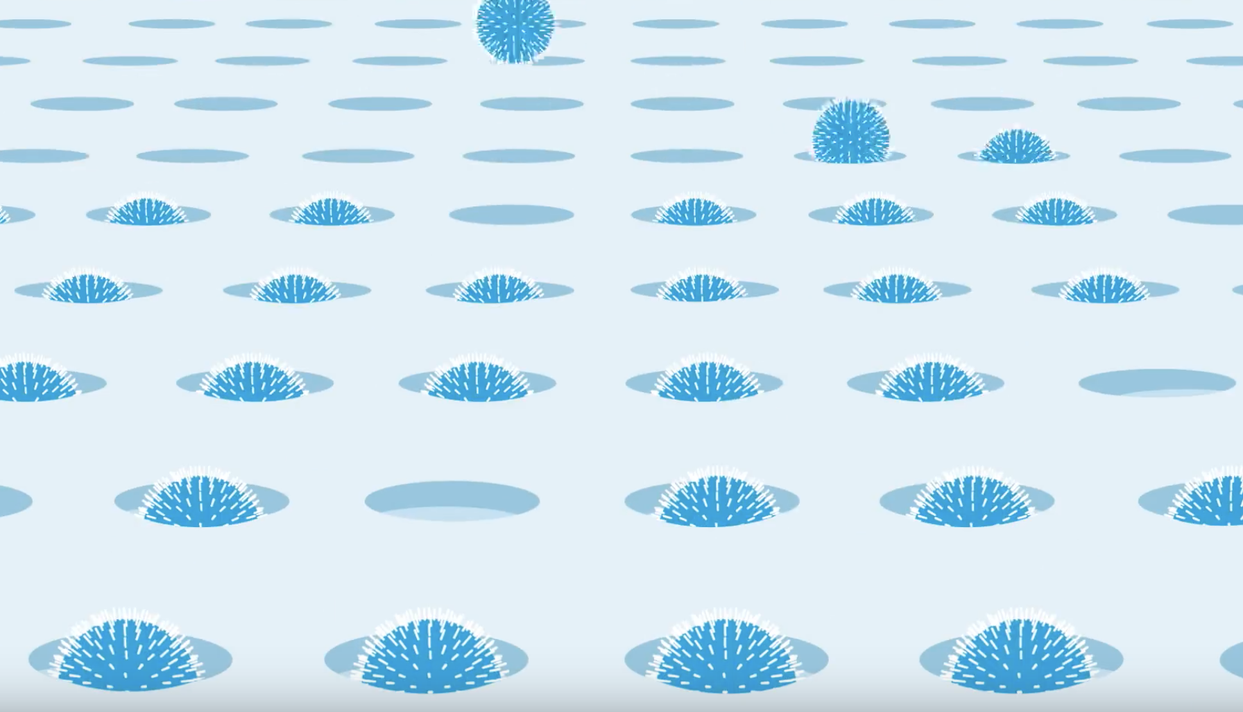
H⁺ - changes pH of solution in the well - layer beneath the well measures that pH change and converts it to Voltage - Voltage change recorded → nucleotide was incorporated - process is repeated every 15 seconds with a different nucleotide washing over the chip
Application : whole genome sequencing, identifying association of genomic variations with different diseases, targeted

