Slide 1
NGS in pathogen detection
Adriana Ključarić

Slide 2
Workflow for mNGS
1. Genomic DNA is extracted and fragmented
2. Adaptors are attached for barcoding and library sequencing preparations
3. The fragments of DNA are simultanously and independantly sequenced
4. Human- related DNA sequence reads are removed
5. Contigs of long DNA stretches are assembbled from shorter sequences
6. Contigs are aligned to a reference database for classification
(* contigs → Few overlapping sequence reads are pieced together to produce a single longer sequence )

Slide 3
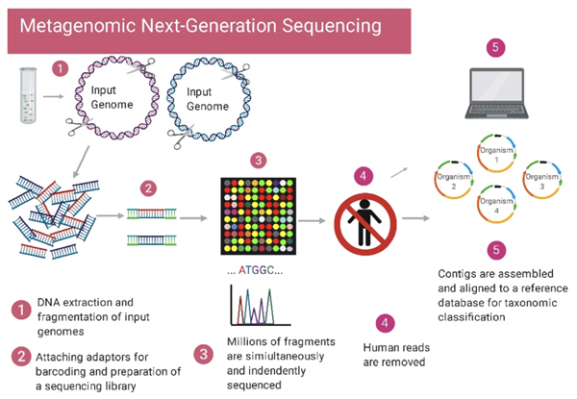

Slide 4
Targeted vs Untargeted shotgun metagenomic next-generation approaches
PCR- targeted mNGS approach → uses primers designed from regions such as rRNA genees that are universally conserved among bacteria or fungi or parasites
Other sets of primers can be designed to target a defined set of pathogens and/or genes and used for multiplex reverse transcription PCR
NGS library preparation and sequencing of the resultant amplicons enable pathogen identification down to the genus or species level

Slide 5
Targeted vs Untargeted shotgun metagenomic next-generation approaches
Metagenomic sequencing → entails unbiased shotgun sequencing of all microbial and host nucleic acids present in a sample
Dna library → identification of bacteria, fungi, DNA viruses, parasites
RNA library → identification of RNA viruses and RNA sequencing- based human host transcriptome profiling
No primers or probes are used in unbiased mNGS, majority of reads corresptonds to the human host → detection of pathogens from metagenomic libraries is a ’needle- in-a- haystack endeavour
Optional capture probe enrichment step using magnetic beads enables targeted mNGS of pathogens and/or genes from metagenomic libraries

Slide 6
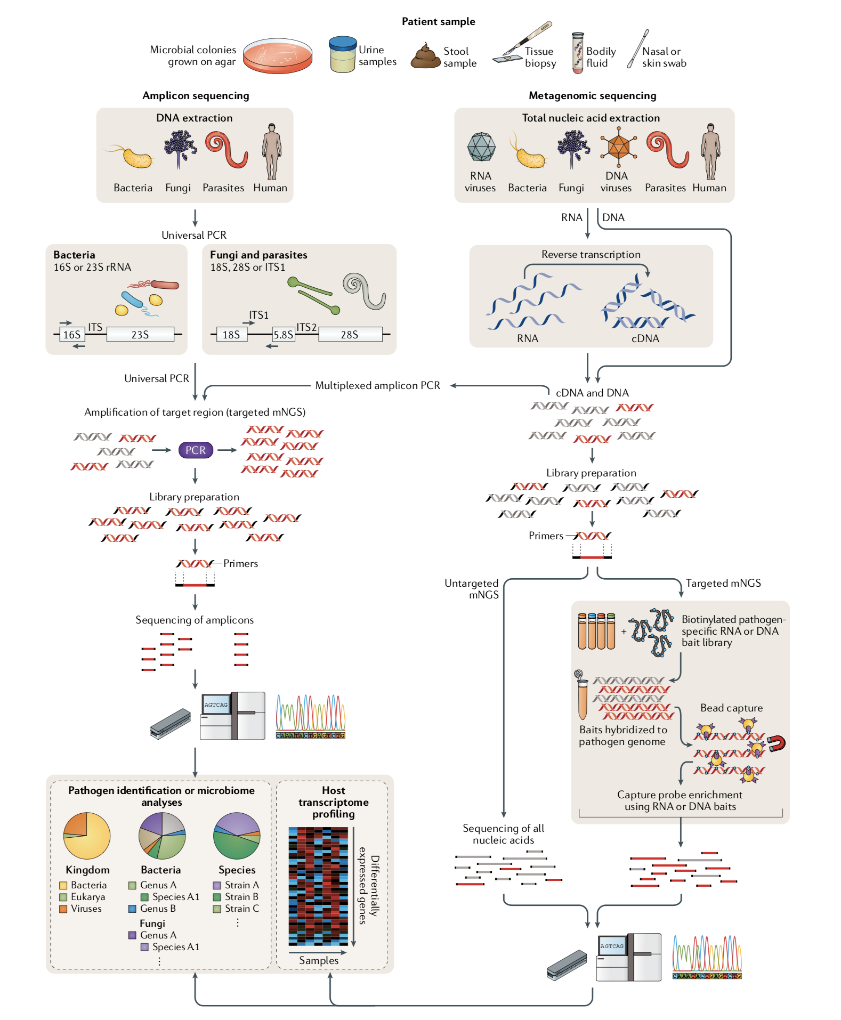

Slide 7
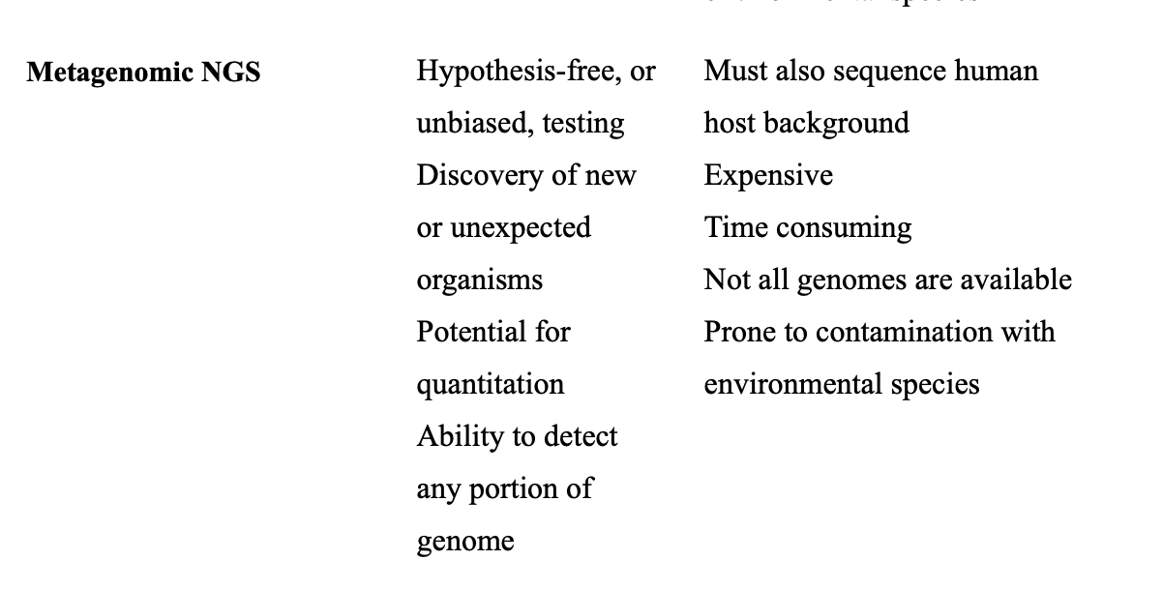

Slide 8
FDA- ARGOS
database with public quality-controlled reference genomes for diagnostic use and regulatory science
initially collecting and sequencing 2000 microbes that include biothreat microorganisms, common clinical pathogens and closely related species.

