Slide 1
Nanopore sequencing
by Daniel Huebner
09.01.2020

Slide 2
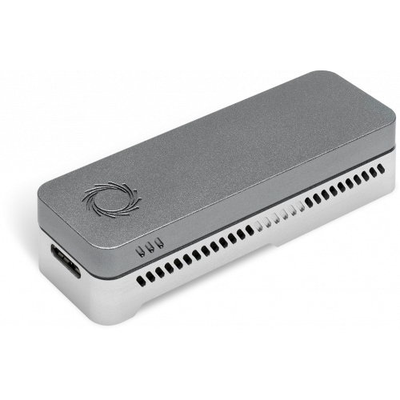
About
third generation sequencing
can sequence a strand of DNA without PCR or chemical labeling
low cost
real time result display

Slide 3
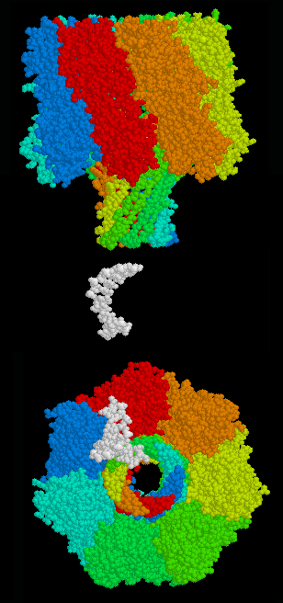
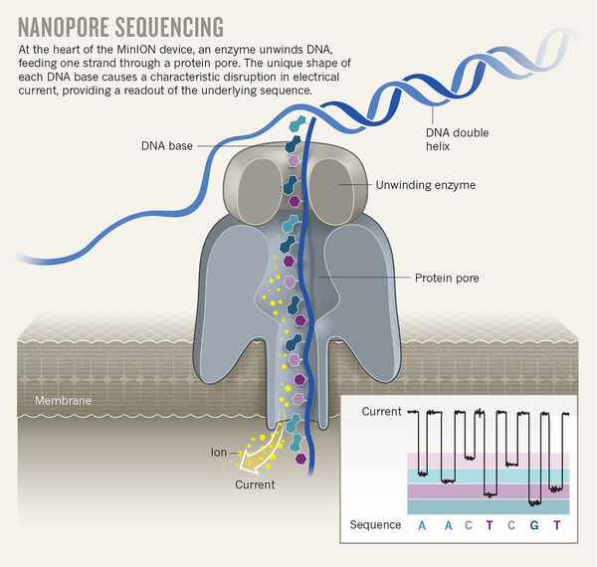
Structure
small transmembrane proteins (porins) located in an electrically resistant polymer membrane

Slide 4
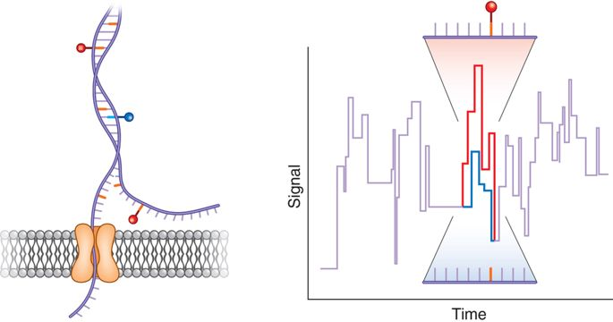
Function
as an analyte passes through the electric current which is passed through the pore is disrupted
every nucleotide has a certain „signature”

