Slide 1
A family with paraplegia
by Daniel Huebner

Slide 2
Background
Three brothers from a consanguineous family, in the age range from pre-adolescent to adult
Their symptoms include severe intellectual disability, tetraspasticity with dyskinetic movements, and dysmetry of the upper limbs
Walking only short distances with a walking frame, or not at all
Speech is absent, but there is some language understanding

Slide 3
Filtering process
Due to the fact, that it must be a hereditary disease we can exclude all de novo mutations
Any common and silent mutations can also be neglected due to obvious reasons
Also parent homozygote are irrelevant as they didn’t have the disease. This is also the argumentation to only consider homozygote of the boys

Slide 4
Phenotype affecting genes
MFF (Plays a role in mitochondrial and peroxisomal fission; highly expressed in heart, kidney, liver, brain, muscle, and stomach)
An autosomal recessive disorder characterized by delayed psychomotor development, severe hypotonia with inability to walk and microcephaly
SPART (May be implicated in endosomal trafficking, or microtubule dynamics, or both; highly expressed in adipose tissue)
neurodegenerative disorder characterized by a slow, gradual, progressive weakness and spasticity of the lower limbs

Slide 5
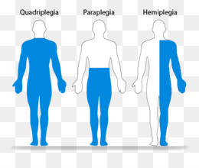
Troyer syndrome
autosomal recessive disease
caused by mutation in SPG20 (encodes spartin)
Rate of progression and the severity of symptoms are quite variable
Initial symptoms may include difficulty with balance, weakness and stiffness in the legs, muscle spasms, and dragging the toes when walking

Slide 6
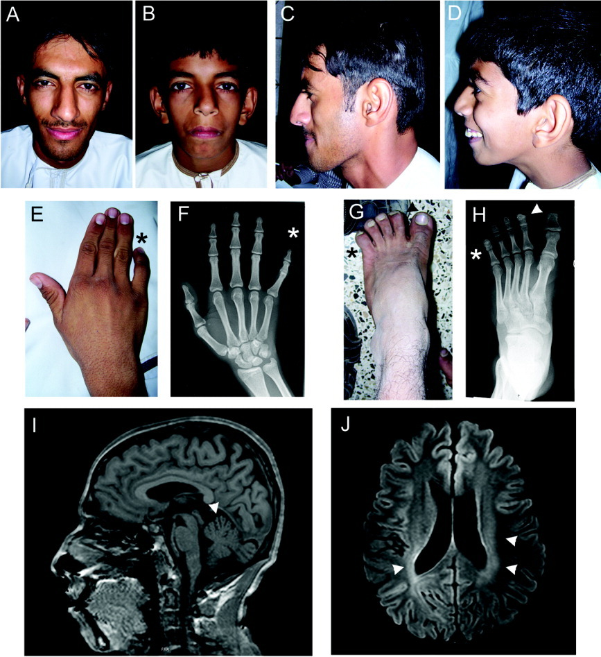
Troyer syndrome
Bladder problems may occur
Weakness and stiffness in the legs can spread to other body parts
dysarthria, distal amyotrophy, mild developmental delay and short stature

