Slide 1
Aspirin
The mechanism of its action and breakdown
Kim Dehling

Slide 2
Cyclooxygenase
Cyclooxygenase 1
known as prostaglandin G/H synthase 1, prostaglandin-endoperoxide synthase 1 or prostaglandin H2 synthase 1
encoded by PTGS1
used for basic housekeeping messages throughout the body
Cyclooxygenase 2
known as Prostaglandin-endoperoxide synthase 2

Slide 3
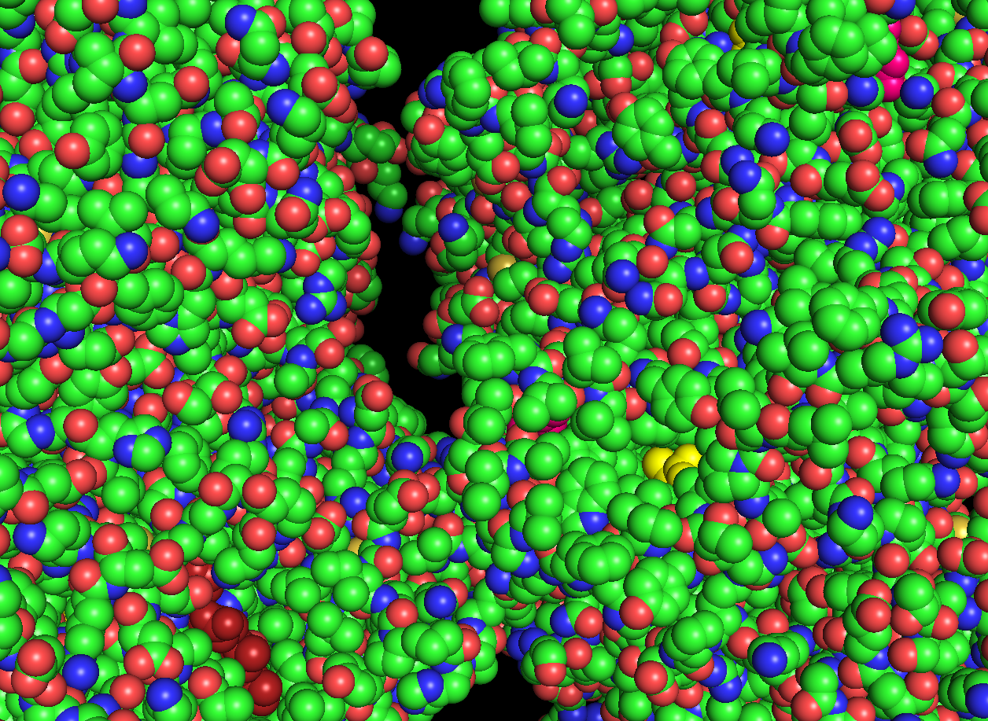
residue of interest
bioactive molecule
heme

Slide 4
Mechanism of Action
- vasoconstriciton
- induces platelet aggregation
opposite of TXA2
- pain
- fever
- increase of RBF
- increase of uterine contractions

Slide 5
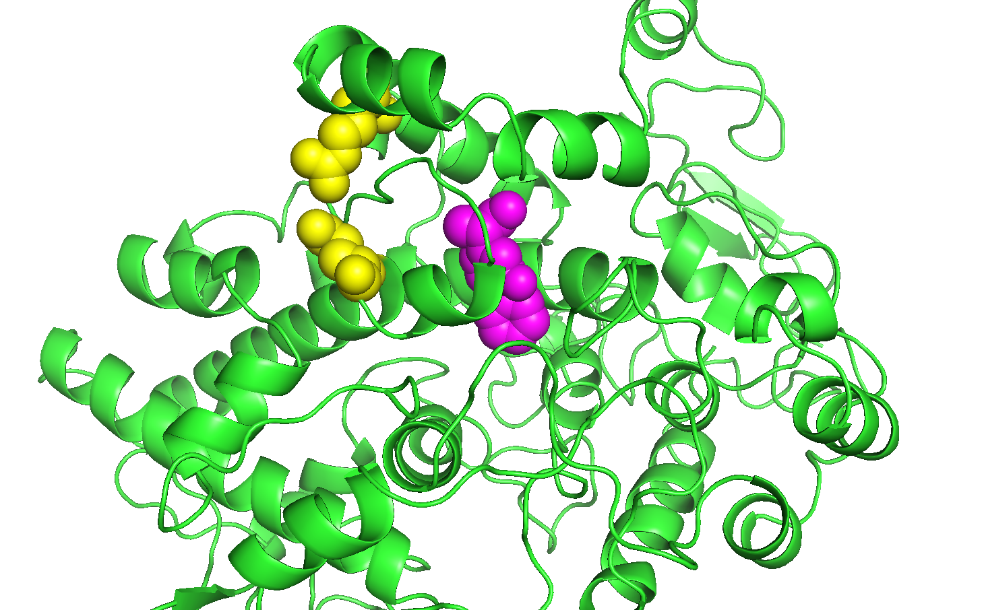
Aspirin
bioactive compound:

Slide 6
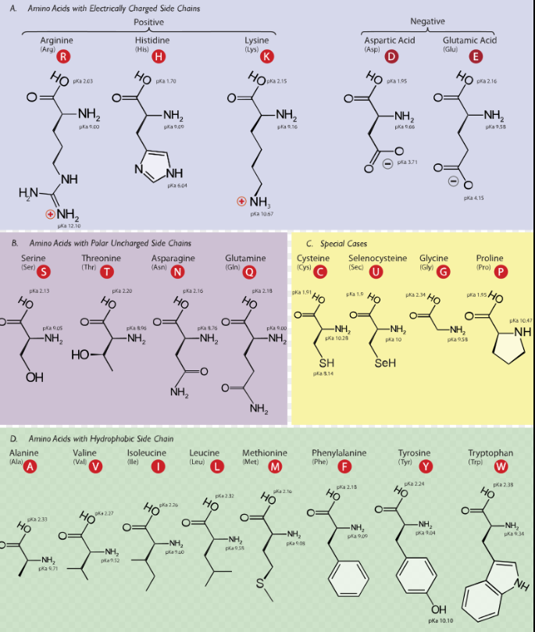
Mutation
incidence of 14 individuals (heterozygotes) in 125 720 people
covalent bond between arginine and aspartic acid
mutation on R108 will change arginine to tryptophan
loss of salt bridge (aspirin will bind more weakly)

