Slide 1
Breast Cancer 1 early onset
Kim Dehling

Slide 2
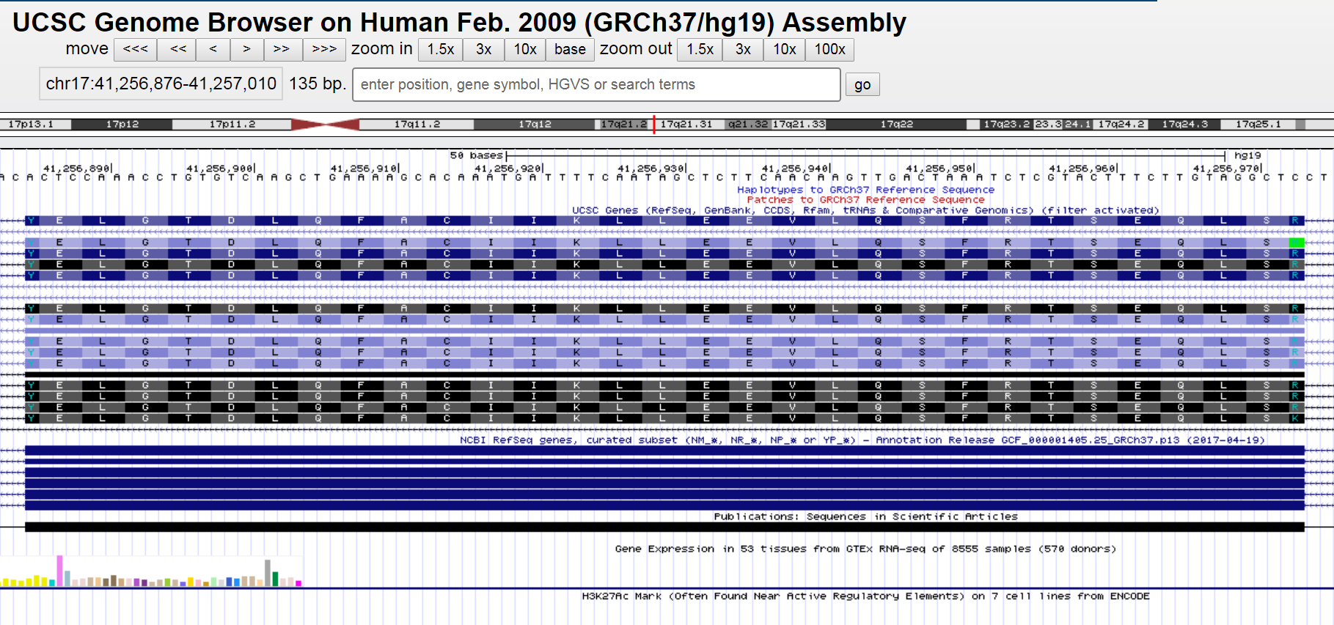
The Genome

Slide 3
Overview
BCRA 1 gene → protein coding
encodes a nuclear phosphoprotein that plays a role in maintaining genomic stability
acts as a tumor suppressor
forms a large multi-subunit protein complex with
tumor suppressors
DNA damage sensors
signal transducers
→ BRCA1-associated genome surveillance complex (BASC)

Slide 4
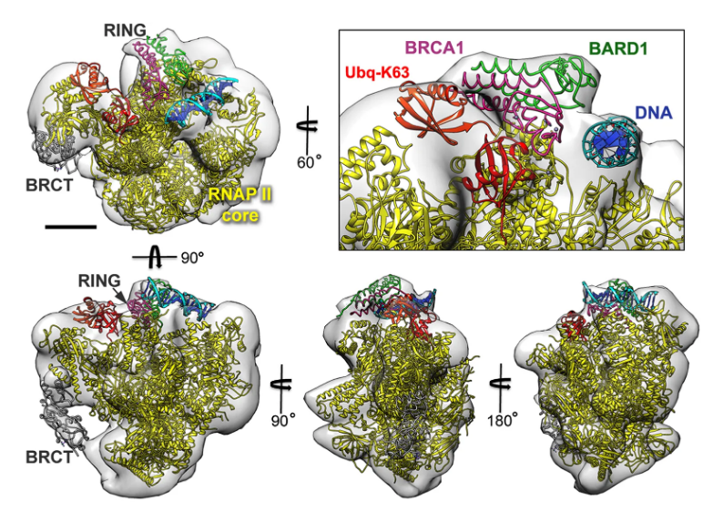
Overview

Slide 5
Overview
associates with RNA polymerase II
interacts with histone deacetylase complexes
→ plays a role in transcription, DNA repair of double-stranded breaks & recombination

Slide 6
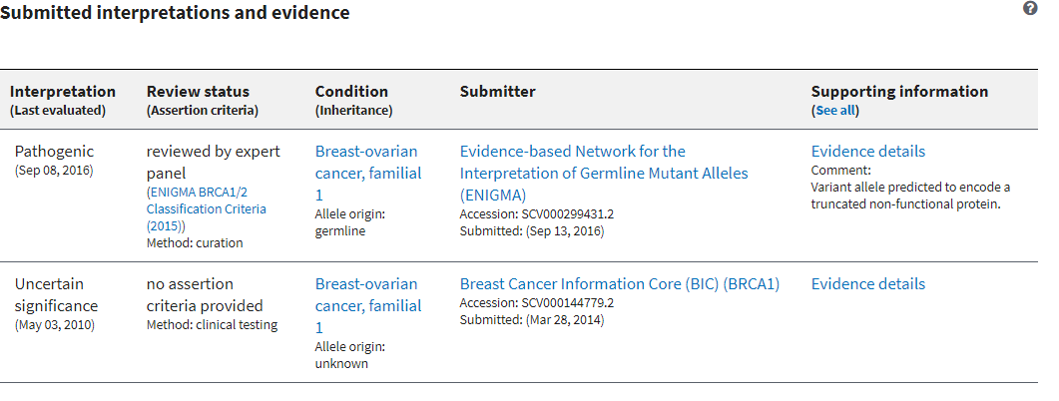
Variation ID: 125634
Chr17: 41,256,943 (on Assembly GRCh37)
Variant type: Deletion
Variant length: 1 bp
Cytogenetic location: 17q21.31
Molecular consequence: frameshift mutation
Protein change: Q81fs

Slide 7
Epidemiology
responsible for approx. 40% of inherited breast cancers & more than 80% of inherited breast and ovarian cancers
women have a 2% chance of getting ovarian cancer in their lifetime
screening all 27 million women over 30 in the UK (Journal of the National Cancer Institute)
prevent 64,500 more breast cancers
prevent 17,500 more ovarian cancers
save 12,300 more lives

