Slide 1
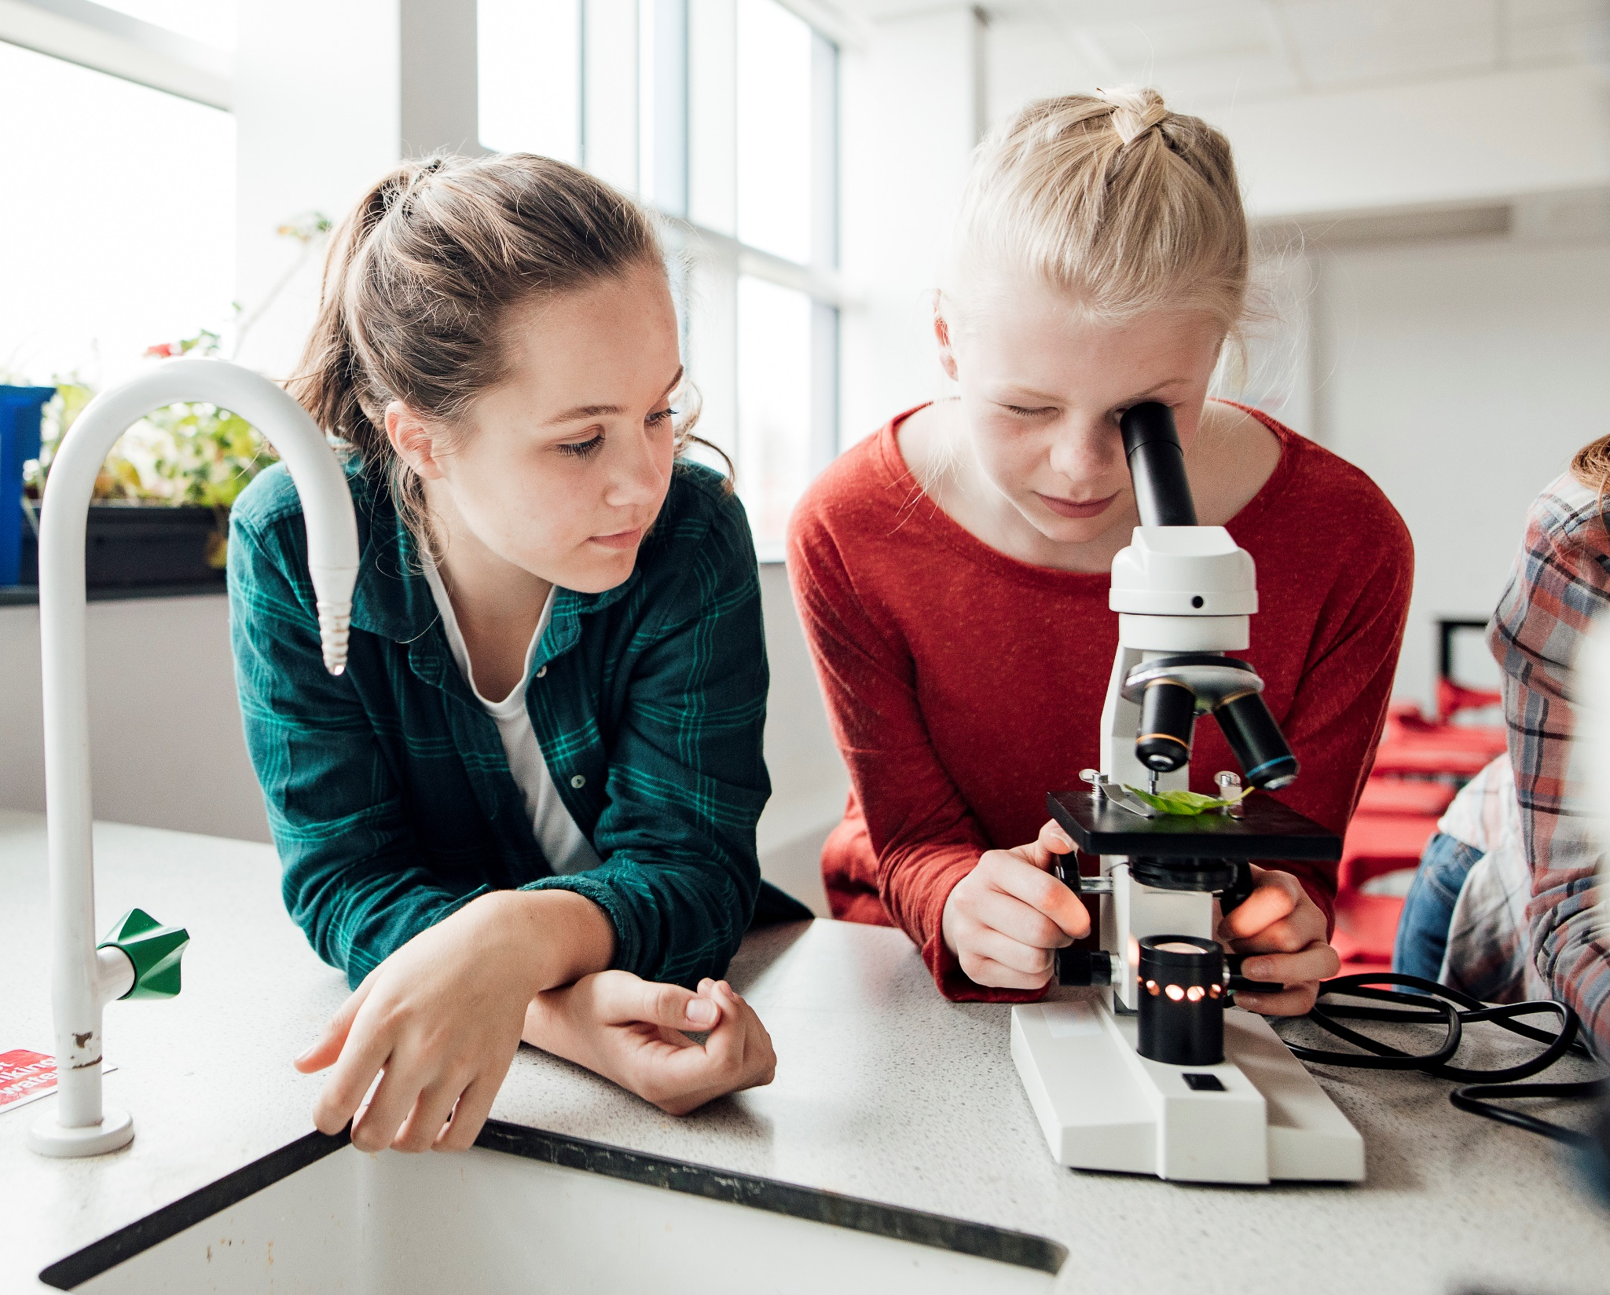
Sanger Sequencing
The chain termiination method - Kim Dehling

Slide 2
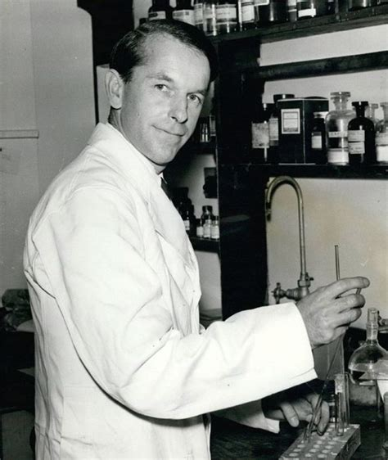
HISTORY
Developed in 1977 by Frederick Sanger (British biochemist)
used to determine the sequences of many relatively small fragments of human DNA
fragments were aligned based on overlapping portions to assemble the sequences of larger regions of DNA

Slide 3
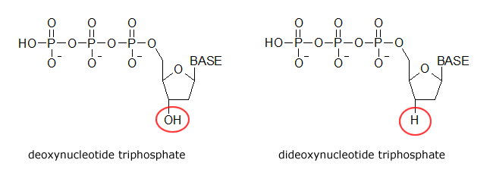
Needed for Sanger sequencing
DNA polymerase
Primer (single-stranded DNA that binds to the template DNA → "starter" for polymerase)
DNA nucleotides (dATP, dTTP, dCTP, dGTP)
template DNA to be sequenced
Dideoxy/chain-terminating versions of all four nucleotides (ddATP, ddTTP, ddCTP, ddGTP) → labeled with different color of dye

Slide 4
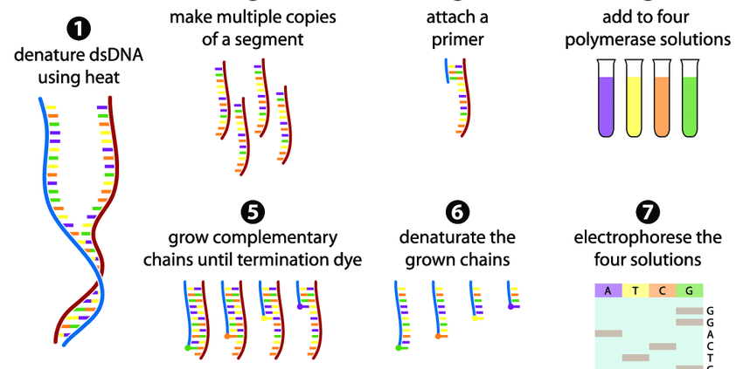
Method of sequencing
capillary gel electrophoresis is used to read the labelled nucleotide
Data is recorded by a detector & read through a chromatogram

Slide 5
Uses and Limitations
high-quality sequence for “long” stretches of DNA (up ~900bp)
used to sequence individual pieces of DNA
Bacterial plasmids
DNA copied in PCR
Limitations
Expensive
Inefficient for large-scale projects (e.g. entire genome)

