Slide 1
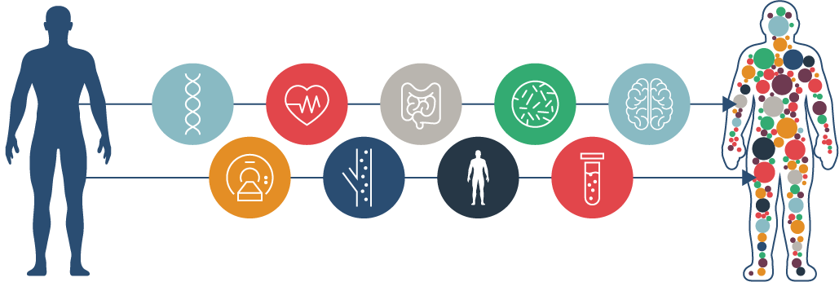
Whole genome sequencing
Kim Dehling

Slide 2
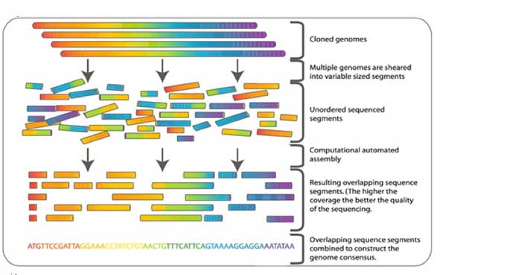
Overview
comprehensive method for analyzing entire genomes
to identify inherited disorders, characterize mutations that drive cancer progression & to track disease outbreaks
suggestive of known genetic conditions that are not detectable by exome sequencing

Slide 3
Benefits and Limitations
Advantages
Allows examination of:
single nucleotide variants
smaller insertion-deletions (indels)
copy-number variations in coding and non-coding regions of the genome
Simpler sample preparation (than WES)
Ability to identify structural variants and chromosome breakpoints in noncoding regions
Disadvantages
More expensive than WES
→feasible to increase number of samples to be sequenced

Slide 4
Disorders that can be reliably diagnosed
Missense or nonsense variants that
Are rare in the population
Have been previously reported as pathogenic in the literature
Small insertions or deletions (<50 bp) within non-repetitive DNA

Slide 5
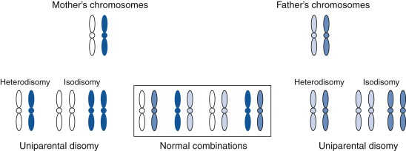
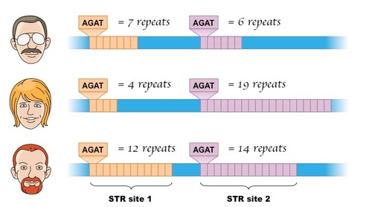
Disorders that can´t be reliably identified
Uniparental disomy
Nucleotide repeat expansions (e.g. Huntingtons)
Imprinting errors

Slide 6
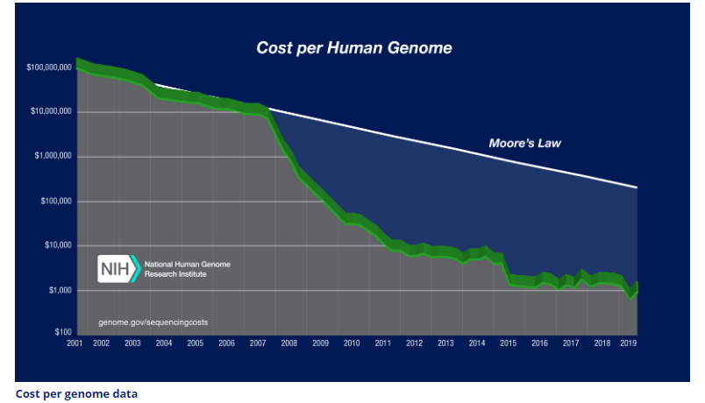
Cost of Whole Genome Sequencing
WGS at depth of ~35x: 1700$/sample (Genohub)
WES at depth of ~100x: 550$/sample (Genohub)
According to National Human Genome Research Institute

Slide 7
Cost of Whole Genome Sequencing
Dante Labs
BGI

Slide 8
Application of WGS
To screen newborns for childhood diseases
detection of rare disorders that can be prevented or better treated
To reveal carrier status for autosomal recessive disorders

