Slide 1
Case 1: A wrinkly woman
Sophia Kalem – Kim Dehling

Slide 2
Medical Findings
The patient has dry, thin, wrinkled skin, making her look much older than her actual age (33). Subcutaneous fat layer thinned out. Low muscle tone. Hair, nails and teeth normal. Cardiovascular evaluation by echocardiography revealed mitral valve prolapse and diffuse changes in myocardium. Ophthalmologic examination demonstrated exotropia and myopic astigmatism of both eyes. Intelligence normal. No family history of similar conditions.
high-yield findings
dry, thin, wrinkled skin → older than her actual age
low muscle tone
mitral valve prolapse, diffuse changes in myocardium
exotropia & myotic astigmatism
intelligence normal
no family history

Slide 3
Search
Total Variants: 15668
Filters used
remove common (5022)
remove silent (4978)
exonic only (600)
de novo only (43)

Slide 4
Selection
Gene Affected | ADAMTS2 | ELN | SACS
Function | Cleaves the propeptides of type I & II collagen, does not act on type III collagen Cleaves lysyl oxidase → produce a short LOX form with reduced collagen-binding activity | Major structural protein of tissues: aorta and nuchal ligament stabilizing arterial structure by regulating proliferation & organization of vascular smooth muscle | Co-chaperone, acts as a regulator of the Hsp70 chaperone machinery may be involved in the processing of ataxia-linked proteins
Expression | Expressed at high level in skin, bone, tendon & aorta at low levels in thymus & brain | Expressed within the outer myometrial smooth muscle & throughout the arteriolar tree of uterus expressed in the large arteries, lung & skin | Highly expressed in the central nervous system found in skeletal muscle

Slide 5
Selection
Clinical Manifestations | ADAMTS2 | ELN | SACS
dry, thin, wrinkled skin → older than her actual age low muscle tone mitral valve prolapse, diffuse changes in myocardium exotropia & myotic astigmatism intelligence normal | Ehlers-Danlos syndrome, dermatosparaxis type group of connective tissue disorder skin hyperextensibility articular hypermobility extreme skin fragility & easy bruising large fontanels blue sclerae puffy eyelids micrognathia (small chin) umbilical hernia short fingers | Cutis laxa, autosomal dominant loose, hyperextensible skin with decreased resilience & elasticity → premature aged appearance face, hands, feet, joints, & torso may be differentially affected Additional variable clinical features: gastrointestinal diverticula hernia genital prolapse Rare manifestations: pulmonary artery stenosis aortic aneurysm bronchiectasis emphysema | Spastic ataxia Charlevoix-Saguenay type neurodegenerative disease early-onset cerebellar ataxia spasticity retinal hypermyelination axonal & demyelinating neuropathy with loss of sensory nerve conduction & reduced motor conduction velocity dysarthria distal muscle wasting nystagmus defect in conjugate pursuit ocular movements frequent presence of mitral valve prolapse

Slide 6
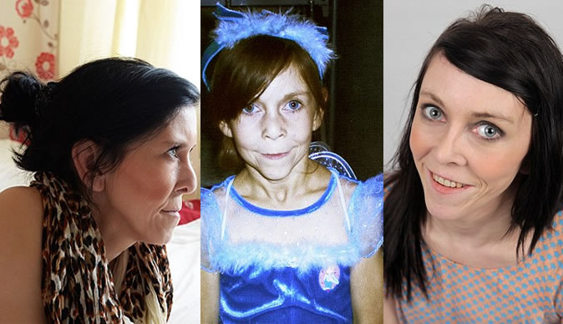
Result
most probably Cutis Laxa due to prominent signs
knock-out criteria: neurodegenerative disease
Cutis Laxa: Ehler-Danlos:

