Slide 1
Gene Therapy – Virus Vectors
Sophia Kalem – Kim Dehling

Slide 2
gene Therapy - Overview
Experimental technique that uses genes to treat or prevent disease
Approaches:
Replacing mutated gene with a healthy copy of the gene
Inactivating (“knocking out”) a mutated gene that is functioning improperly
Introducing a new gene into the body

Slide 3
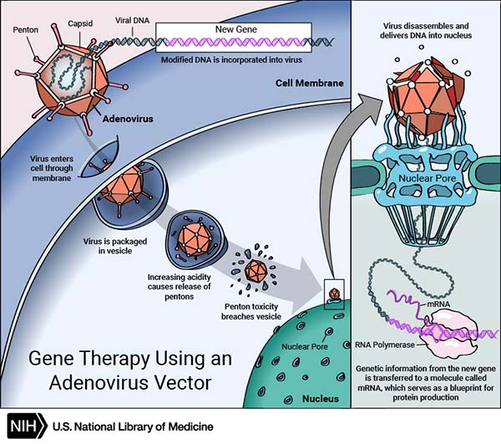
How does gene therapy work?
carrier (vector) is genetically engineered to deliver the gene
viruses are modified so they can`t cause disease
vector can be injected or given intravenously
use adeno- or retroviruses

Slide 4
rISK fACTORS
viruses can infect cancer cells as well
new gene might be inserted in the wrong location in the DNA → harmful mutations
clinical trials for patients with XSCID → corrective transgene using a retrovirus
→ T cell leukemia in 4 of 20 patients
transferred gene can be overexpressed → too much of the missing protein

Slide 5
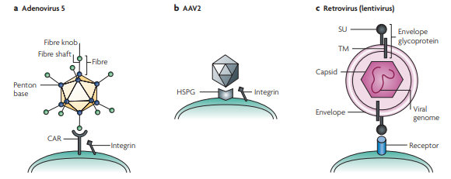
Pseudotyping
vectors have been developed in which the endogenous viral envelope proteins have been replaced by envelope proteins from other viruses
to limit or expand the range of cells susceptible to transduction by a gene therapy vector

Slide 6
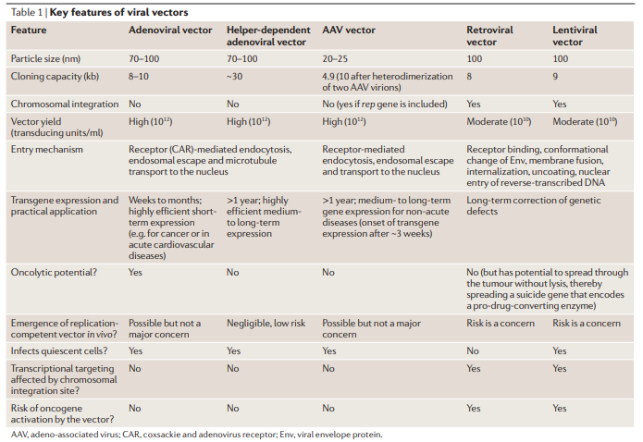

Slide 7
Niemann-Pick disease
severe inherited metabolic disorders, in which sphingomyelin accumulates in lysosomes in cells
Mutations in NPC1 or NPC2
deficiency of sphingomyelinase
resulting in the accumulation of sphingomyelin within lysosomes in the macrophage-monocyte phagocyte lineage.
Affected cells become enlarged, sometimes up to 90 μm in diameter (normal 10-30)
85% of cases has an extremely poor prognosis, with most cases being fatal by the age of 18 months

Slide 8
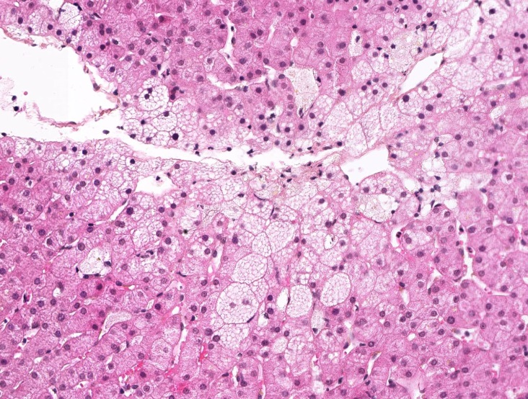
Niemann-Pick disease

Slide 9
Study on Mice
therapy involved inserting a functional copy of the NPC1 gene into mice with the disease
used a non-disease-causing virus called the adeno-associated virus serotype 9 (AAV9) to transfer functioning NPC1 to the cells
a functioning NPC1 gene successfully crossed the blood-brain barrier, reaching cells in the brain and elsewhere
Once inside cells, the normal NPC1 gene was then able to make the functional NPC1 protein to correct the cell defects.
the treated animals were then found to have less severe NPC1 symptoms
With a single injection, mice showed improvements in motor coordination, weight gain and longevity
However, to be effective, compound has to be given three times a week for the life of the mouse and does not provide a true cure

