Slide 1
Clinical Applications
Daniel – Adriana – Sophia - Kim

Slide 2
Circulating Tumor DNA
Kim Dehling

Slide 3
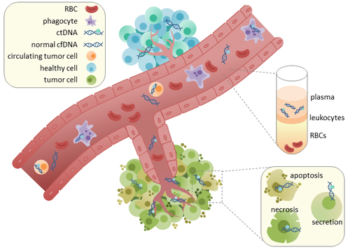
Definition
tumor-derived fragmented DNA in the bloodstream that is not associated with cells
may reflect the entire tumor genome
originates directly from the tumor or from circulating tumor cells (CTCs)

Slide 4
In Contrast: CTCs
CTCs are shed from either primary or secondary tumor sites → migrate into blood
extremely rare
widespread in cancer research
large size → multiple methods to extract them
include erythrocyte lysis, cell centrifugation & washing → may lead to insufficient capture or cell damage
epigenetic silencing in promoter regions of tumor suppressor genes can be clearly confirmed in CTCs
Clinical Application
prostate cancer: prostate-specific antigen (PSA) & prostate-specific membrane antigen (PSMA) → possible predictors of response to antiandrogenic therapy
NSCLC: epidermal growth factor receptor (EGFR) → point mutations are successfully targetable by TKIs
high-methylation profiles significantly correlate with BRAF mutations (poorer prognosis in colorectal CA)

Slide 5
Pre-analytical considerations
Plasma is preferred over serum → no contamination of cfDNA by genomic DNA derived from lysis of leukocytes
cell stabilization tubes (not EDTA)
if EDTA: process sample to plasma within 2–4h
no heparinised tubes
heparin inhibits PCR by mimicking helical structure of DNA
temperature → increase of cfDNA if at room temperature

Slide 6
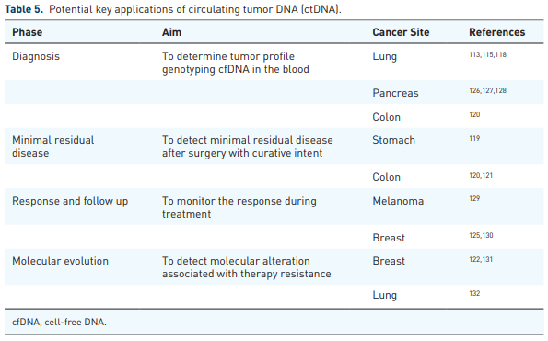
Clinical Application
ctDNA provides useful baseline information
subclinical conditions of patients
cases of unknown neoplasms that correlate with specific mutations
characteristics of ctDNA are the mirror of the tumor’s molecular profile → consider treatment options
liquid biopsy is approved for clinical practice use only in NSCLC

Slide 7
Non-Blood Liquid Biopsy
Sophia Kalem

Slide 8
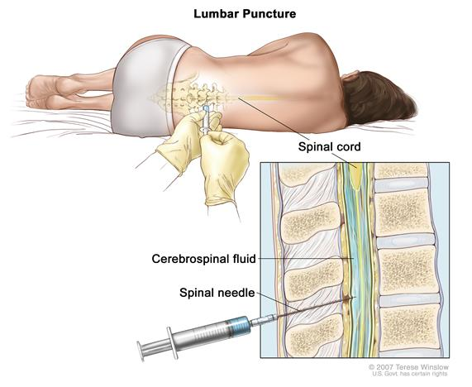
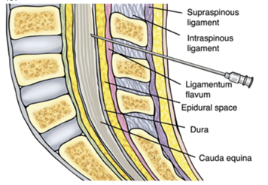
Definition
less invasive
routinely done in CNS lymphoma, medulloblastoma, germ cell tumours
In patients who have a tumour that cannot be approached surgically, lumbar puncture offers an opportunity to obtain a molecular signature and potentially a definitive diagnosis
cheaper than brain tumor biopsy
can be done on a larger scale -> clinical research
looking for ctDNA (circulating tumor DNA)

Slide 9
Study
performed to research the effectivity of liquor biopsy in brain tumors
CSF from 85 patients with gliomas (agressive brain tumor)
diagnosis of glioma had been established by prior tumour biopsy or resection
All patients had received treatment for glioma before CSF collection, including surgery, radiation, and at least one systemic tumour-directed chemotherapy
tumour-derived DNA was detected in CSF from 42 out of 85 patients (49.4%)

Slide 10
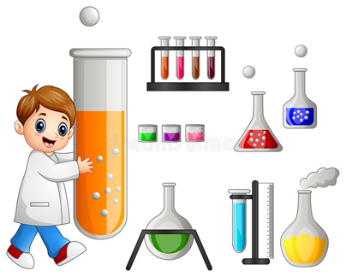
Processing
Isolation of ctDNA
Isolation of tumour and germline DNA
Targeted capture and sequencing
Comparison of genomic alterations in CSF and tumour
Statistical analysis

Slide 11
Outcome
study shows that tumour-derived DNA in CSF from patients with glioma provides a comprehensive and genetically faithful representation of the tumour genome at the time of the CSF collection.
The frequency and type of alterations in the CSF closely resembled the genomic landscape of diffuse glioma
observed high concordance between CSF and tumour DNA in patients who underwent both lumbar puncture and neurosurgical tumour resection within a few weeks

Slide 12
NGS in pre-natal diagnostics
Adriana Ključarić

Slide 13
Screening test
Drawing blood from a pregnang woman and analyzing DNA that is found in the bloodstream outside the cells
Some of this cell- free DNA comes from the fetus and is transferred from placenta to the bloodstream
(~13% of cell-free DNA isolated from maternal plasma during pregnancy is fetal in origin)

Slide 14
Origin of cffDNA: placental trophoblast
Analysis: no associated risk of spontaneous abortion
- has to be backed up with tests such as amniocentesis or chorionic villi sampling

Slide 15
Circulating Fetal Cells sequencing for prenatal testing study
95 women ( Texas and NY), between 8 and 13 weeks pregnancy
Separation of single circulating trophoblast from the rest of the blood (magnetic- activated cell sorting → using antibodies attached to magnetic beads to grab hold of the cells with the corresponding antigens)
Analyzing the cells by using whole- genome sequencing to detect abnormal numbers of chromosomes or variation in the copy of number of genes
Reliability → 96%
2 trophoblasts for every 10 milliliters of blood
To detect and analyze individual trophoblast → ~ $3000

Slide 16
NGS in newborn child
by Daniel Huebner

Slide 17
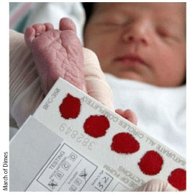
DBS
Dried blood spot sampling
used to screen fo congenital metabolic disases
has been preformed for over 50 years
can be tested for than 50 seperate analytes
broad spectrum of analysis due to usage of mass spectrometry

Slide 18
 | circulating tumor DNA | non-blood liquid biopsy | NGS in pre-natal diagnostics | DBS
Advantages | less invasive than lumbar puncture mirror of the tumor’s molecular profile targeted approach → specific genes and mutations detection of minimal residual disease (MRD) | less invasive than brain surgery cheaper easy to perform can be used if tumor is not surgically approachable reliable DNA results that match with the tumor | less invasive then amniocentesis and chorionic villus sampling | low volume requirements easy to attain (few to no training required) sample is easy to transport when dry it is stable at ambient temperature used for clinical and pre-clinical pharmacokinetic studies
Disadvantages | pre-analytical considerations use of various amplification and sequencing methods untargeted approach → all genes (more expensive, lower resolution) approved for clinical practice use only in NSCLC | not be used as the only diagnostic method needs futher studies to back up the results | high cost not 100% accurate (still requires confirmation) approximately 2 trophoblast per 10ml of blood cells can be at a different stage in life cycle (dividing/replicating DNA, apoptosis…) → affects the results of sequencing | analysis that requires intact whole cells or measures volatile analytes many hours are required for the sample to dry → contamination drying rate can be variable proper application of blood to the filter paper

