Slide 1
Osimertinib
general information
mechanism
picture
Sophia Kalem

Slide 2
General Information

Slide 3
General Information
80-85% of patients suffer from NSCLC
advanced spaces have bad prognosis if treated with traditional chemotherapy
EGFR gene encodes a growth factor receptor
cancer cells: hypersensitive receptors or receptor over expression

Slide 4
Mechanism
Mutation in the EGFR gene (10-30%)
exon 19 deletions, L858 variant (drug sensitive)
T790M (drug resistant)
goal is to develope a drug that target resistant an variant types but do not affect wild type ->osimertinib

Slide 5
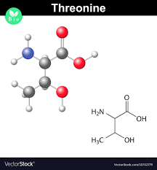
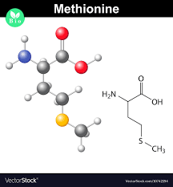
T790M
Mutation on the 790th AA
Threonine to Methionine

Slide 6
Wild Type

Slide 7
Mutant Type

