Slide 1
FGFR gene
Sophia Kalem

Slide 2
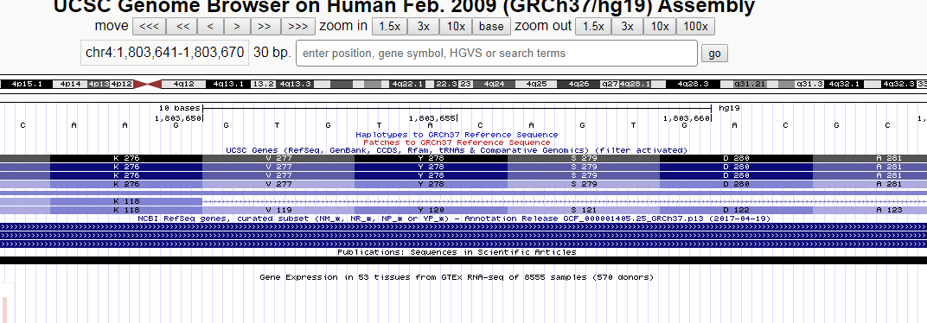

Slide 3
The FGFR Gene
FGFR3 codes for Fibroblast growth factor receptor
regulation of cell proliferation, determination of cell type, angiogenesis, wound healing, and embryo development
AGT->TGT; Serine->Cysteine
Chr4:1,803,657

Slide 4
Achondroplasia
most common form of short limb dwarfism
inherited as an autosomal dominant
seven-eighths of cases are the result of new mutation
severity of achondroplasia tends to be reduced with increasing parental age
limited number of mutations causes achondroplasia
-> screening

Slide 5
Characteristics
short statue because of short limbs
midface hypoplasia
lumbar lodrosis ect

