Slide 1
Illumina Dye sequencing
Sophia Kalem

Slide 2
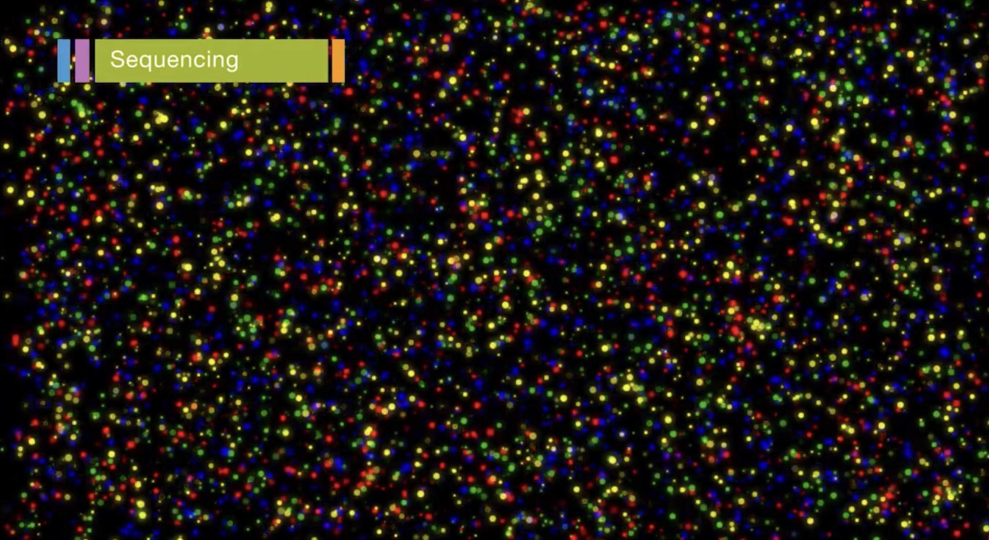
Overview
invented by: Bruno Canard and Simon Sarfati at the Pasteur Institute in Paris
Used for: whole-genome and region sequencing, transcriptome analysis, metagenomics, small RNA discovery, methylation profiling, and genome-wide protein-nucleic acid interaction analysis
Advantage: Due to the automated nature oit is possible to sequence multiple strands at once -> quick

Slide 3
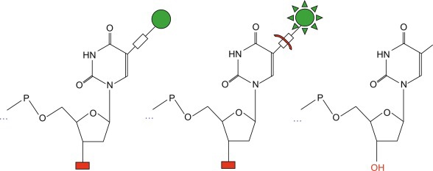
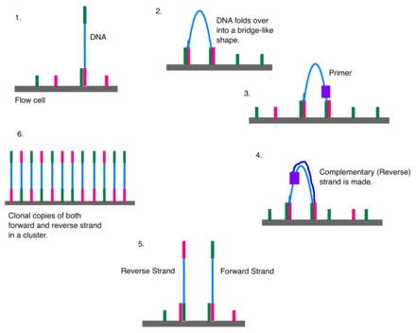
Method
Dye labeled nucleotides
Red, green, both, none
Amplifying DNA

Slide 4
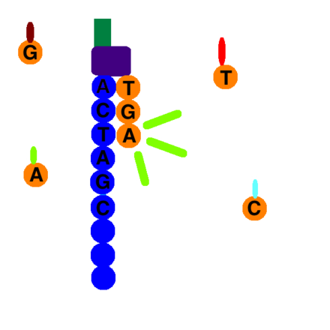
MEthod
Every time a nucleotide binds, it emits light

Slide 5
Method
Forward and reverse reads are overlapped to obtain the sequence

