Slide 1
Exome sequencing
Sophia Kalem

Slide 2
Why exon sequencing?
effective in the study of rare Mendelian diseases
sequencing an exon is more cost effective than whole genome sequencing (1-5%)
to find mutations in genes already known to cause disease as well as to identify novel genes by comparing exomes from patients with similar features
now increasingly used to complement these other tests

Slide 3
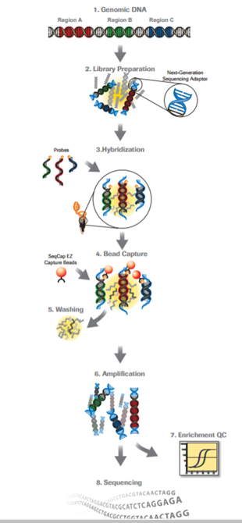
Method

Slide 4
Benefits vs Limitations
targeted to protein coding regions, represent less than 2% of the genome, reduces the cost to sequence a targeted region at a high depth and reduces storage and analysis costs.
Reduced costs make it feasible to increase the number of samples to be sequenced, enabling large population based comparisons
approximately 97% of exons are targeted
~10% of exons may not be covered at sufficient levels to reliably call heterozygous variants

Slide 6
Clinical Diagnostics
Identification of the underlying disease gene mutation(s) can have major implications for diagnostic and therapeutic approaches
ability to identify mutations in genes that were not tested due to an atypical clinical presentation
ability to identify clinical cases where mutations from different genes contribute to the different phenotypes in the same patient

Slide 7
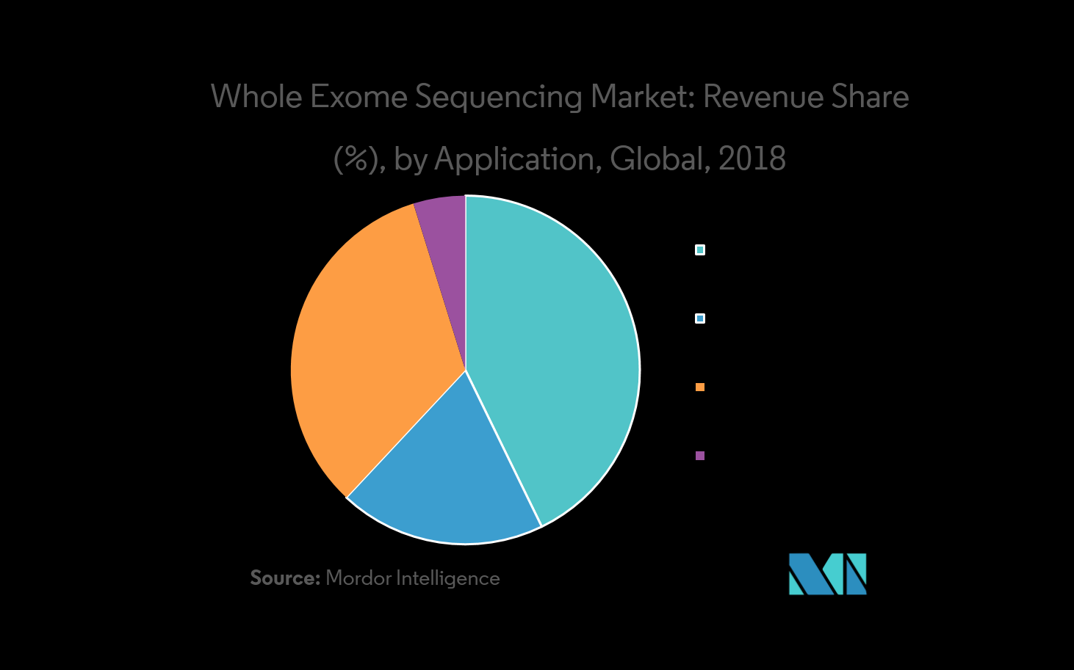
Diagnostics
Drug Development
prsonalized medicine
other applications (Agriculture, Animal research

