Slide 1
Early infantile epileptic encephalopathy
Vinko Beg, Matej Španić

Slide 2
Case report:
Two sisters, from healthy non-cosanguineous parents. Proband: he pregnancy was uneventful, and she was delivered s pontaneously with no asphyxia at 39 weeks of gestation. At 3 months of age, she experienced epileptic spasms and electroencephalography (EEG) revealed hypsarrhythmia. At 3 years 2 months, she exhibited focal impaired awareness seizures, which responded well to a combination of clonazepam (CZP) and zonisamide. At 4 years of age, myoclonic seizures appeared and occurred five times per week despite the administration of antiepileptic medications. Her psychomotor development was severely delayed. Her younger sister present simialr symptoms with epileptic spasms onset at the age of 4 months.

Slide 3
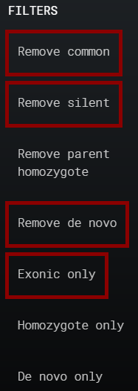
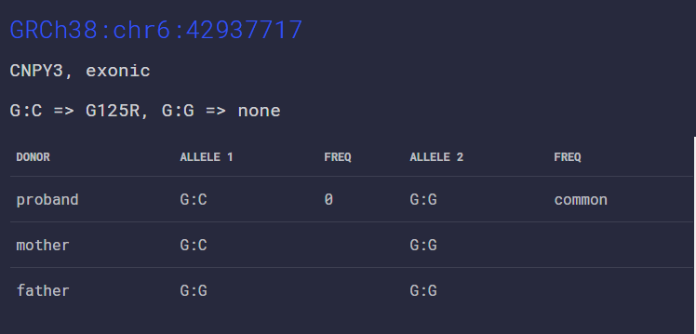
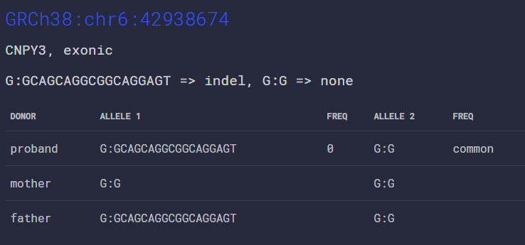
složeni heterozigot

