Slide 1
Portable sequencer in the fight against infectious disease
Vinko Beg, Matej Španić

Slide 2
DNA sequencer uses nanopore protein to recognize the nucleotide in question. Here, the disturbance in the basal electrical current inside the protein caused by certain nucleotide strands will be recognized as specific patterns and converted into sequences of DNA by specific algorithm
The portable sequencer, MinION, can be transported to countries or locations where performing sequencing is difficult or transferring samples to other countries or locations is forbidden
For example, MinION has been taken to a remote rainforest of Tanzania, Ecuador, the Canadian high Arctic, and even the International Space Station.
MinION helped the surveillance and sequencing of Zika virus in the 2016 Brazil outbreak. During the project, it was found that most of the genome were fragmentary. Low titer was correlated to sequencing less than 50% coverage, so ‘tiling amplification’ was used to amplify the whole genome of Zika virus. This technique also was employed in the Ebola virus (EBOV) outbreak in Guinea to get a high nucleic acid concentration for sequencing

Slide 3
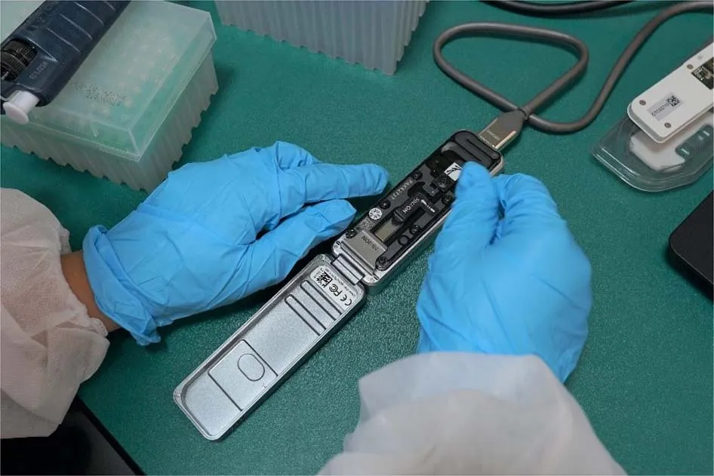
$71.56 for MinION per sample

Slide 4
With the increase of MinION sequencing power, whole-genome sequencing of pathogens and human using MinION has become common practice in the field or clinical settings
Nevertheless, there are many technical difficulties, such as the low titer of the infecting agents and large host DNA background

Slide 5
Host DNA depletion with saponin, negative CpG selection, or physical disruption of bacterial wall may be used to remove or reduce the background DNA and to increase sensitivity
Filtration, nuclease digestion, and random amplification allow reliable recovery of viral genomes
Whole genome amplification by multiple displacement amplification (MDA) can also be performed for low DNA concentration

Slide 6
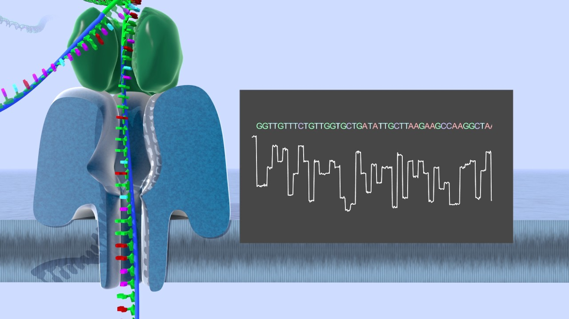
Nanopore sequencing is not limited to DNA
RNA sequencing, either directly or after cDNA conversion
Coronavirus, herpes simplex virus-1, varicella zoster

Slide 7
Other aplications od MinION
Advanced application of MinION in the field of infectious disease is the epigenetic sequencing
In infection, the researches are mainly focused on the changes in host’s DNA methylome, histone marks, and microRNA profiles as a response to pathogen’s invasion
Due to its principle of directly sequencing nucleic acid molecules, any modifications in the nucleotides are also recorded in the raw signals

Slide 8
Theoretically, the method can identify bacteria species and screen for antibiotics resistance simultaneously
Sequencing as a technique may become the gold standard of diagnosis with the advent of portable sequencing
The technology is still evolving but it has shown development in portability, sequencing accuracy, and ease of operation

