Slide 1
CRISPR-Cas 9
Vinko Beg, Tamara Hunjak, Matej Španić

Slide 2
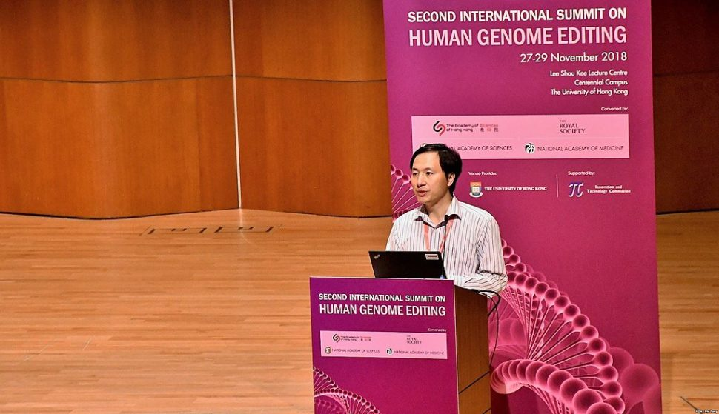

Slide 3
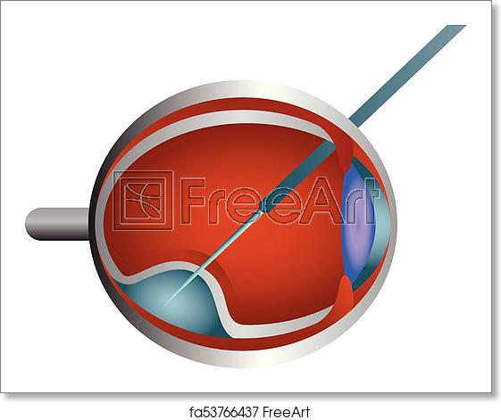
Leberova kongenitalna amauroza
Editas trial
homozygous or compound heterozygous mutation involving c.2991+1655A>G in intron 26 of the CEP290 gene
Drug: AGN-151587

Slide 4
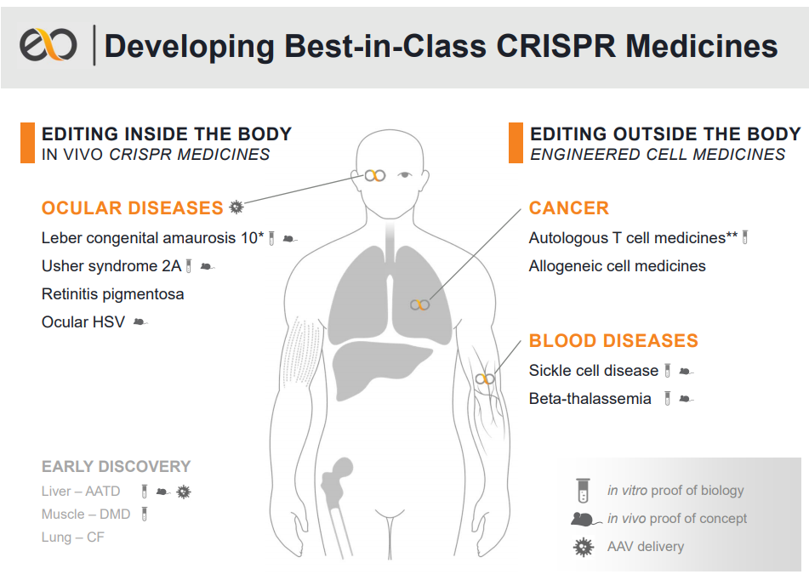

Slide 5
https://youtu.be/UKbrwPL3wXE

