Slide 1
Genetic differences in drug metabolism - the example of NAT2
by Daniel Huebner

Slide 2
Pharmacogenetics
Uses molecular biological techniques to study genes in relation to drug therapy
there are differences in individual responses to drugs
these are mostly in regard to the drugs metabolism and transport in the body

Slide 3
Genetic polymorphism
this occurs if: a single gene responsible for producing a metabolising enzyme has a variant allele with the arbitrary frequency of 1%

Slide 4
N-Acetyltransferase
there is a slow acetylator and a fast acetylator phenotype
acetylation polymorphism describes a type of genetic polymorphism of a drug metabolizing enzyme
each acetylator phenotype experiences toxicity from different drugs
Fast acetylator | Slow acetylator
isoniazid and hydralazine | isoniazid, sulfonamides, procainamide and hydralazine

Slide 5
N-acetyltransferases NAT2
play an important role in the biotransformation of a plethora of aromatic amine and hydrazine drugs
are known to play an important role in the bioactivation of several known carcinogens
polymorphisms in NAT genes have been associated with various cancers

Slide 6
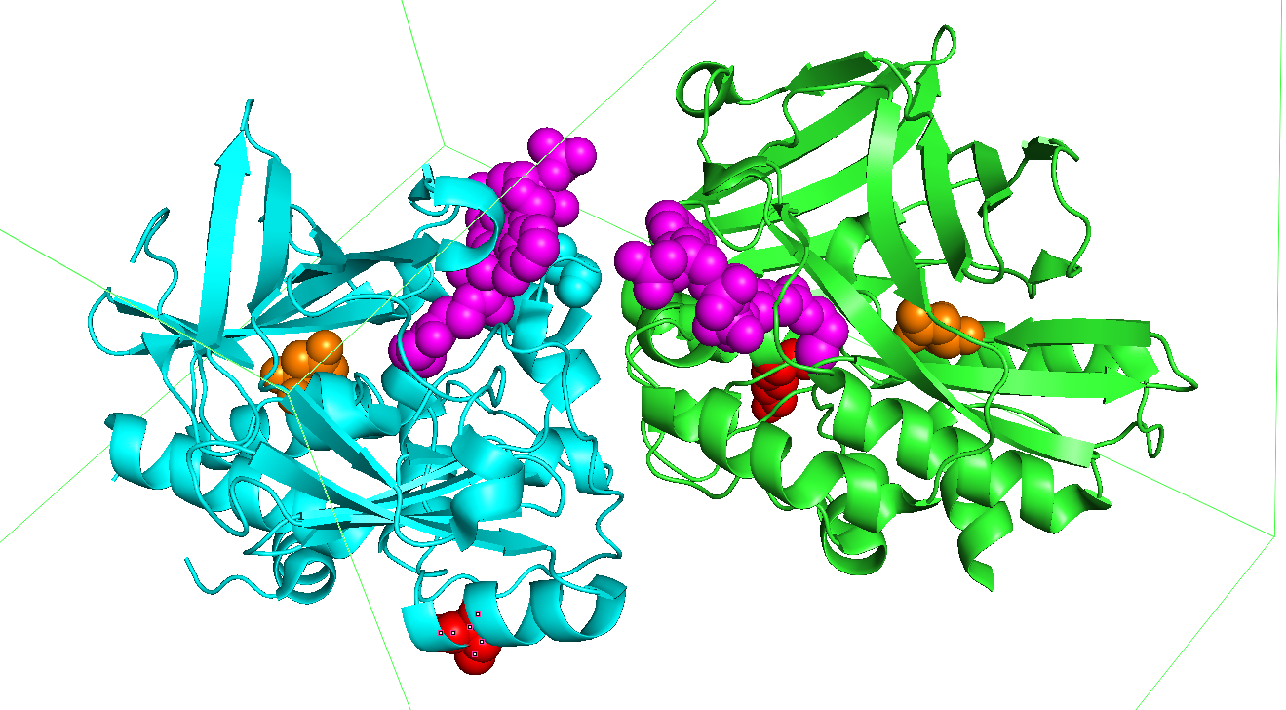
CoA
D122N
D122N

Slide 7
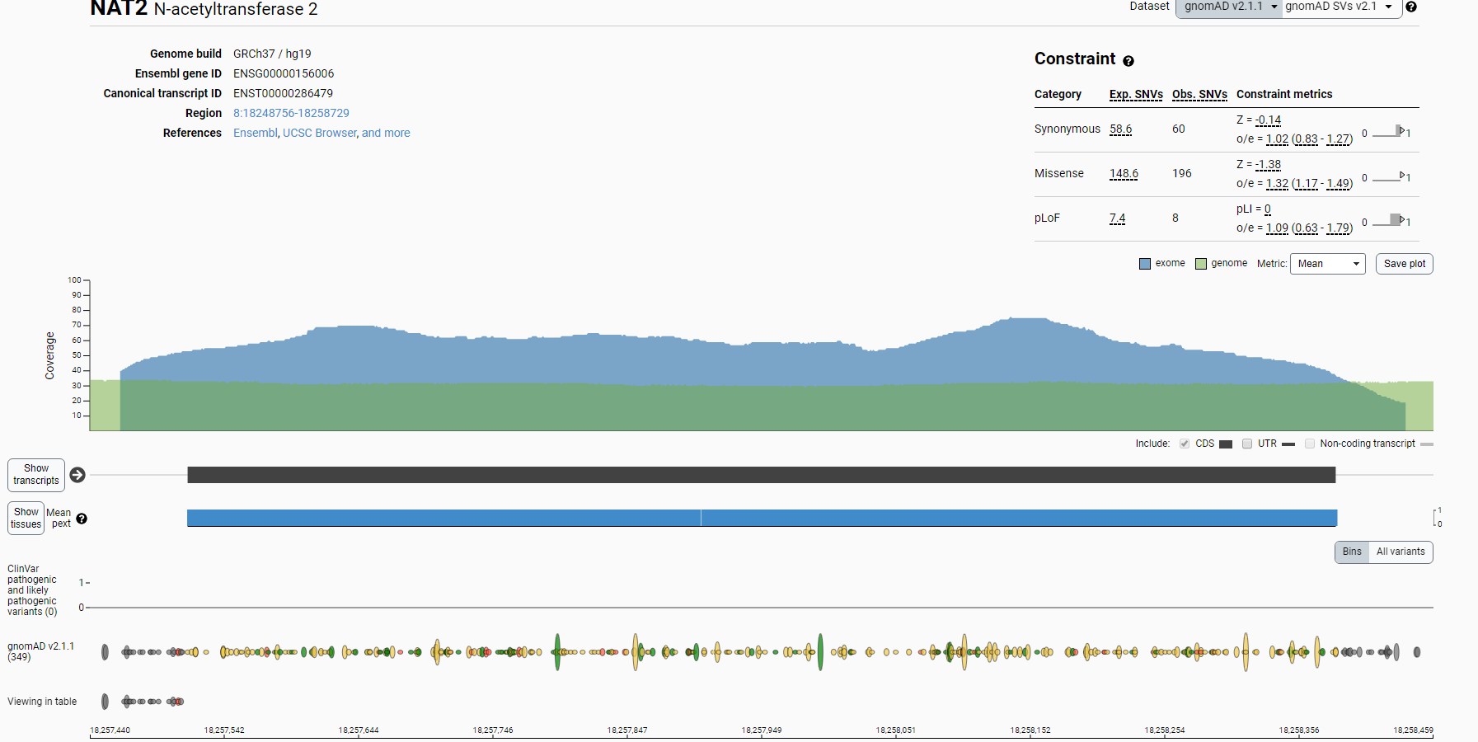
Mutation Frequency

