Slide 1
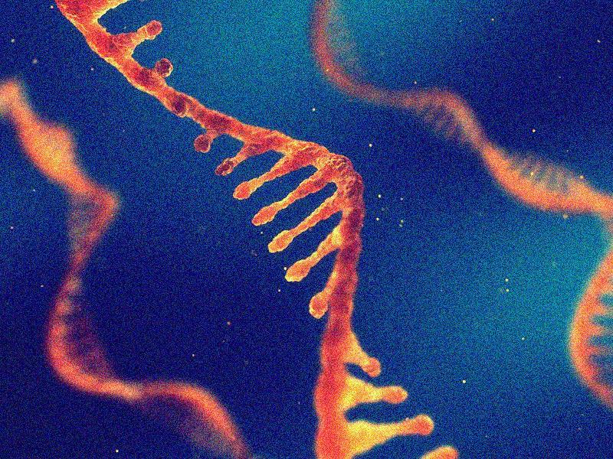
RNA sequencing
by Daniel Huebner

Slide 2
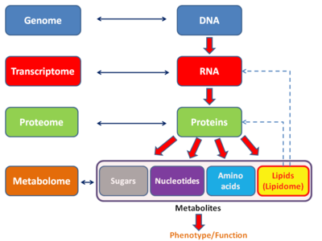
Transcriptome
is the set of all RNA molecules in one cell or a population of cells
may sometimes refer to all RNA or just the mRNA
particularly of interest because it is the part of genome which is „actually being used”

Slide 3
Haplotome or phasing problem

Slide 4
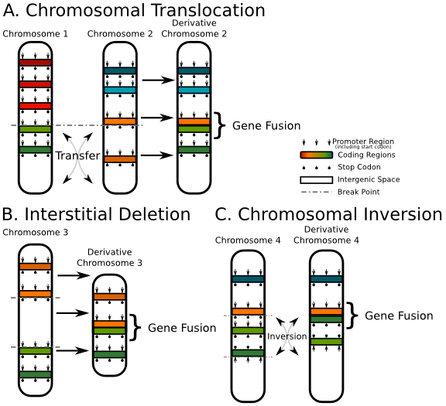
Gene fusion
hybrid gene formed from two previous seperate genes
present in all main types of neoplasia
large scale gene fusion detection by sequencing transcriptome

Slide 5
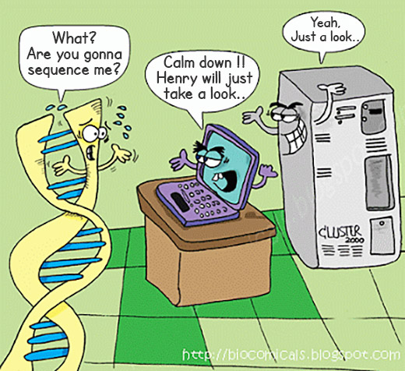
RNAseq
generally uses NGS
is performed to reveal the quantity and composition in a cell a certain moments (transcriptome is constantly changing)
allows insight in splice variations and other post-transcriptional modificitaions

Slide 6
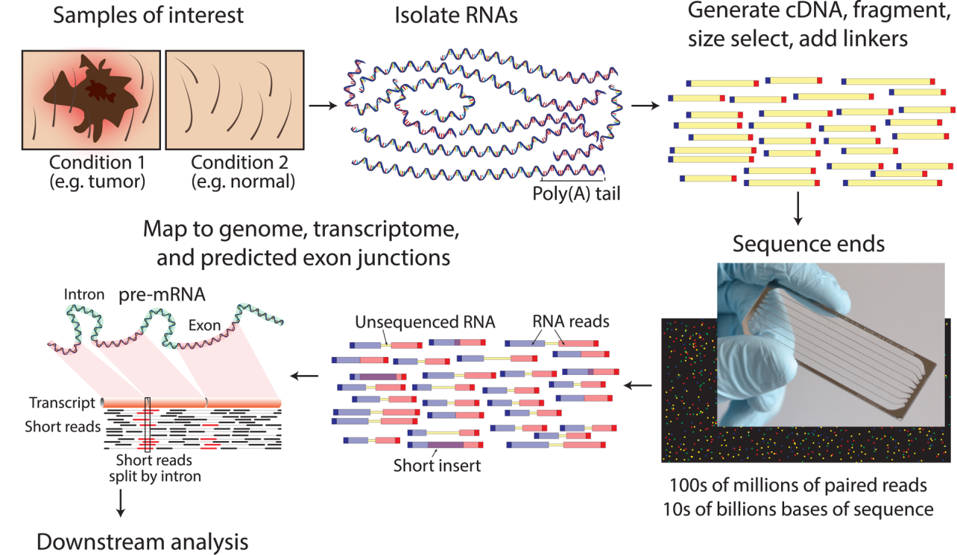
How does RNASeq work?
generally uses NGS
converting RNA into cDNA can result in bias of th sample or artifacts can remain → therefore direct RNA sequencing is the goal

Slide 7
Clinical applications
Identification of fusion genes is crucial to be able to diagnose cancer
prior: chromosome banding analysis, FISH, RT-PCR
hopes now lie in NGS-methods
RNA-seq can decypher heterogenity of cancers by comparing their phenotypes to their molecular underpinnings

